Slide 1
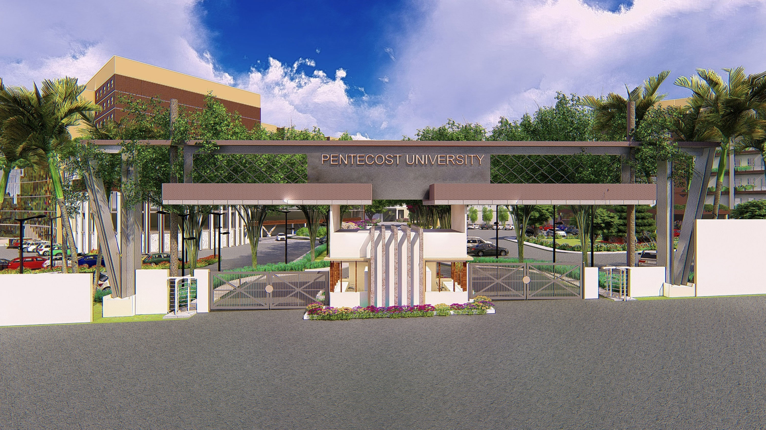
LOAN DEFAULT CLASSIFICATION FOR MICROFINANCE
MACHINE LEARNING CAPSTONE PROJECT

Slide 2
GROUP MEMBERS
GROUP MEMBERS
S/N | NAME | STUDENT ID
1 | KICHASU WUGAJAH VICTOR | PUIT/22110014
2 | ELIZABETH AGBO | PUIT/22110033
3 | ALBERT AGYEI | PUIT/22217130
4 | YAA ABBAN AMOANI
5 | EUGENE ANTWI

Slide 3
INTRODUCTION
Microfinance institutions (MFIs) offer small loans to individuals and small businesses excluded from traditional banks.Major challenge: loan defaults.Goal: Use machine learning to predict loan default likelihood.Importance: Supports financial inclusion and risk reduction.

Slide 4
ASSIGNMENT STATEMENT
PROBLEM STATEMENT
Manual assessment of loan applications is slow and prone to errors.
High loan default rates reduce MFI sustainability.
Need for an automated classification model to identify high-risk borrowers.

Slide 5
ASSIGNMENT STATEMENT
PROJECT OBJECTIVES
Develop a predictive model for loan default classification.
Identify critical risk factors influencing default.
Improve decision-making for microfinance institutions.
Promote data-driven lending practices in Ghana.

Slide 6
ASSIGNMENT STATEMENT
METHODOLOGY OVERVIEW
Key Phases:
Data Collection (Kaggle, UCI, or Dummy Dataset)
Data Preprocessing (Cleaning, Encoding, Scaling)
Model Development (Logistic Regression, Random Forest, SVM)
Evaluation (Accuracy, Confusion Matrix, F1-Score)

Slide 7
ASSIGNMENT STATEMENT
DATASET DESCRIPTION
Dataset features include:
  Age, Income, Loan Amount, Employment Type, Credit Score, Loan Duration.
Target variable: Default Status (0 = Non-Default, 1 = Default)
If no dataset available, synthetic data created using Python.

Slide 8
ASSIGNMENT STATEMENT
MODEL DEVELOPMENT
Algorithms Used:
  Logistic Regression (Baseline)
  Random Forest Classifier (Handles mixed data)
  Support Vector Machine (SVM) (High accuracy)
Sample Code Snippet:
      model = RandomForestClassifier()
      model.fit(X_train, y_train)
      pred = model.predict(X_test)
      print("Accuracy:", accuracy_score(y_test, pred))

Slide 9
ASSIGNMENT STATEMENT
MODEL EVALUATION
Metrics used:
  Accuracy
  Precision & Recall
  F1-Score
  Confusion Matrix
Example Result:
  Accuracy: 87%
  Confusion Matrix:
    [[45 5]
    [4 11]]

Slide 10
ASSIGNMENT STATEMENT
SYSTEM REQUIREMENTS
Component | Minimum | Recommended
Processor | Intel i3 | Intel i5+
RAM | 4 GB | 8 GB
Storage | 10 GB | 20 GB
OS | Windows 10 | Windows 11/ macOS 12

Slide 11
ASSIGNMENT STATEMENT
EXPECTED RESULTS
Accurate classification of borrowers (80–90% accuracy).
Identification of key features influencing default.
Visual representation of model outcomes.
Enhanced decision-making for MFIs.

Slide 12
ASSIGNMENT STATEMENT
REAL-WORLD RELEVANCE
Applicable to Ghanaian MFIs and fintech services.
Reduces default risk and improves loan recovery.
Can integrate with mobile money lending platforms (e.g., MTN QwikLoan, Zeepay).
Encourages responsible lending and economic empowerment.

Slide 13
ASSIGNMENT STATEMENT
CONCLUSION
Machine learning enhances microfinance decision-making.
Automates risk assessment, ensuring fair and accurate predictions.
Promotes financial inclusion and sustainability.
Demonstrates technical understanding and real-world impact.

Slide 14
ASSIGNMENT STATEMENT
REFERENCES
[1] Z. Begiev, Loan Default Prediction Dataset, Kaggle, 2023.
[2] UCI ML Repository, German Credit Data, 2022.
[3] F. Pedregosa et al., Scikit-learn: Machine Learning in Python, JMLR, 2011.
[4] Python Software Foundation, Python 3.10 Documentation, 2023

